Slide 1

Amino Acid Testing
Part Two
Dr. Mark Schauss, DBA

Slide 2
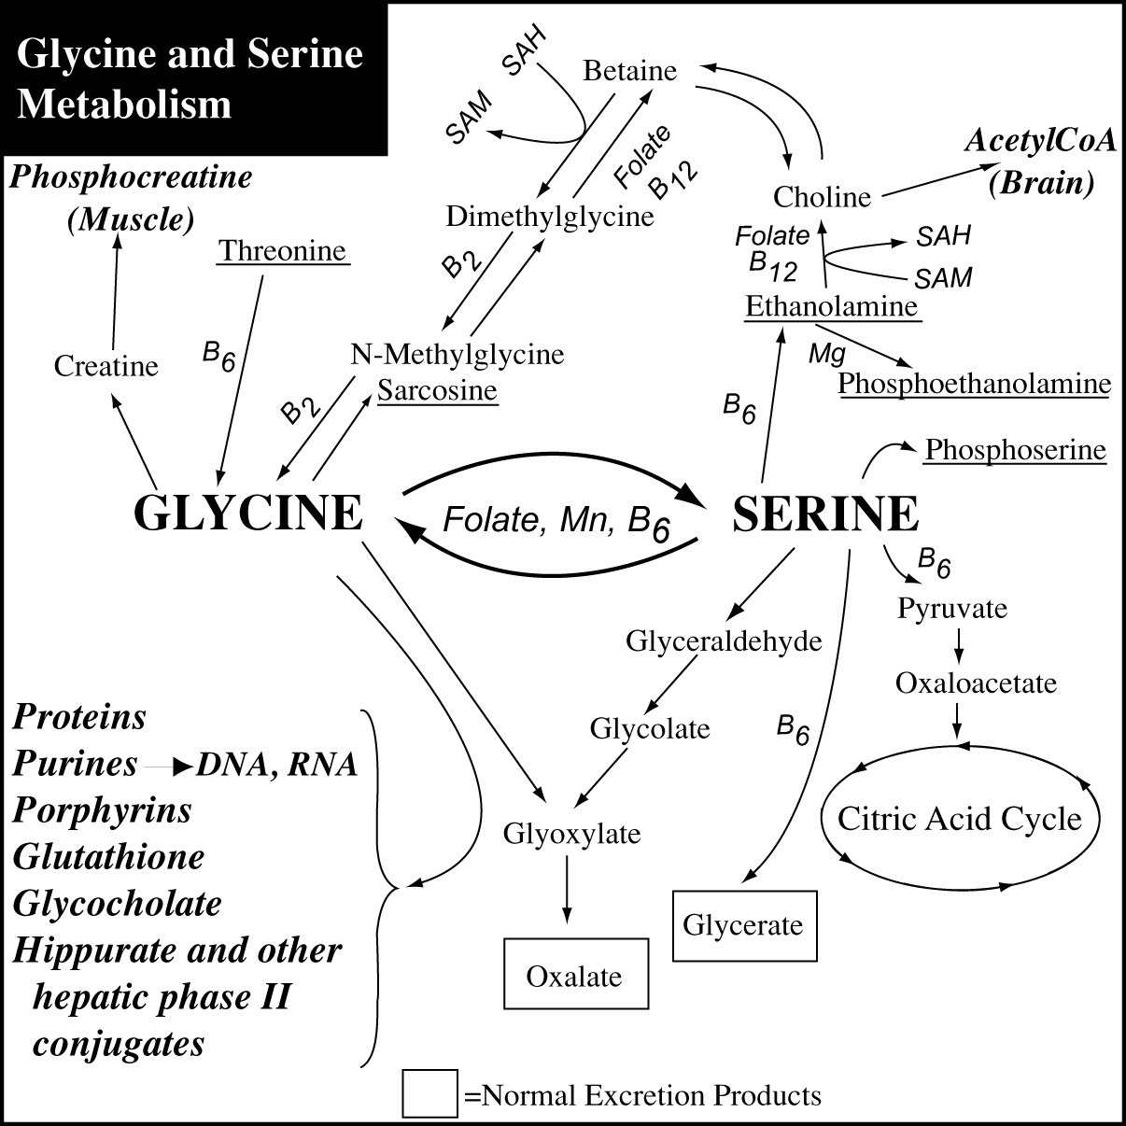
Glycine and Serine Metabolism

Slide 3
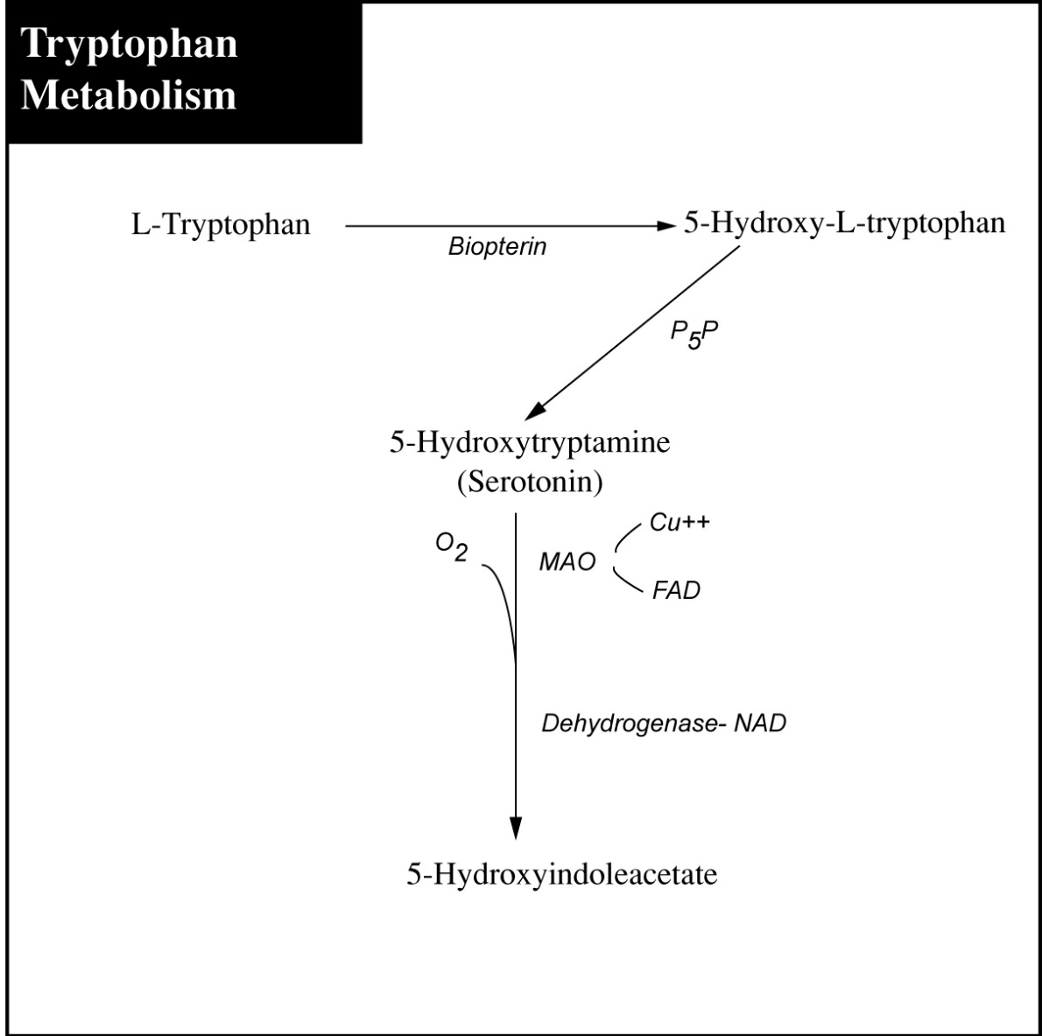
Tryptophan Metabolism

Slide 4
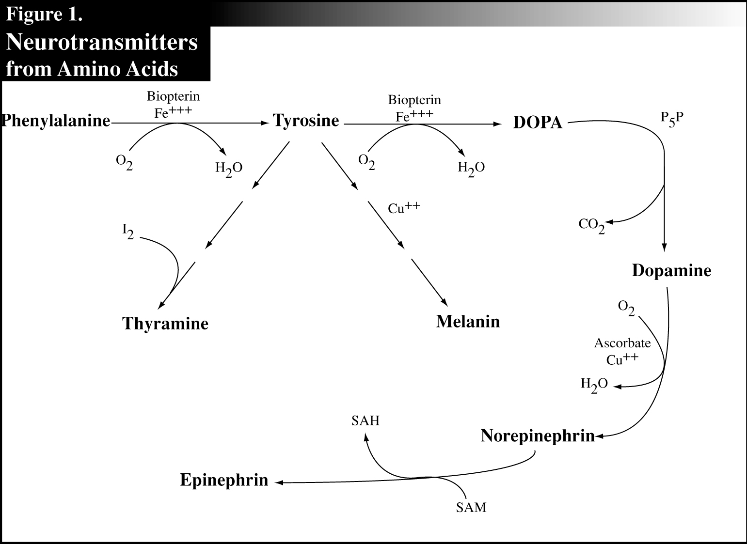
Neurotransmitters from Amino Acids
DHPP - Clostridium

Slide 5
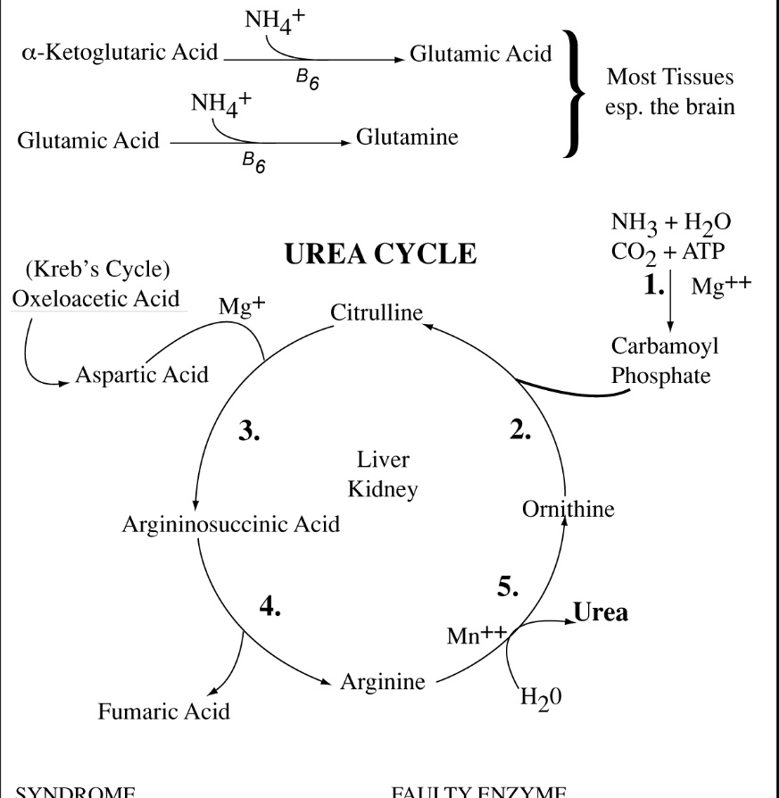
Ammonia Metabolism Pathways

Slide 6
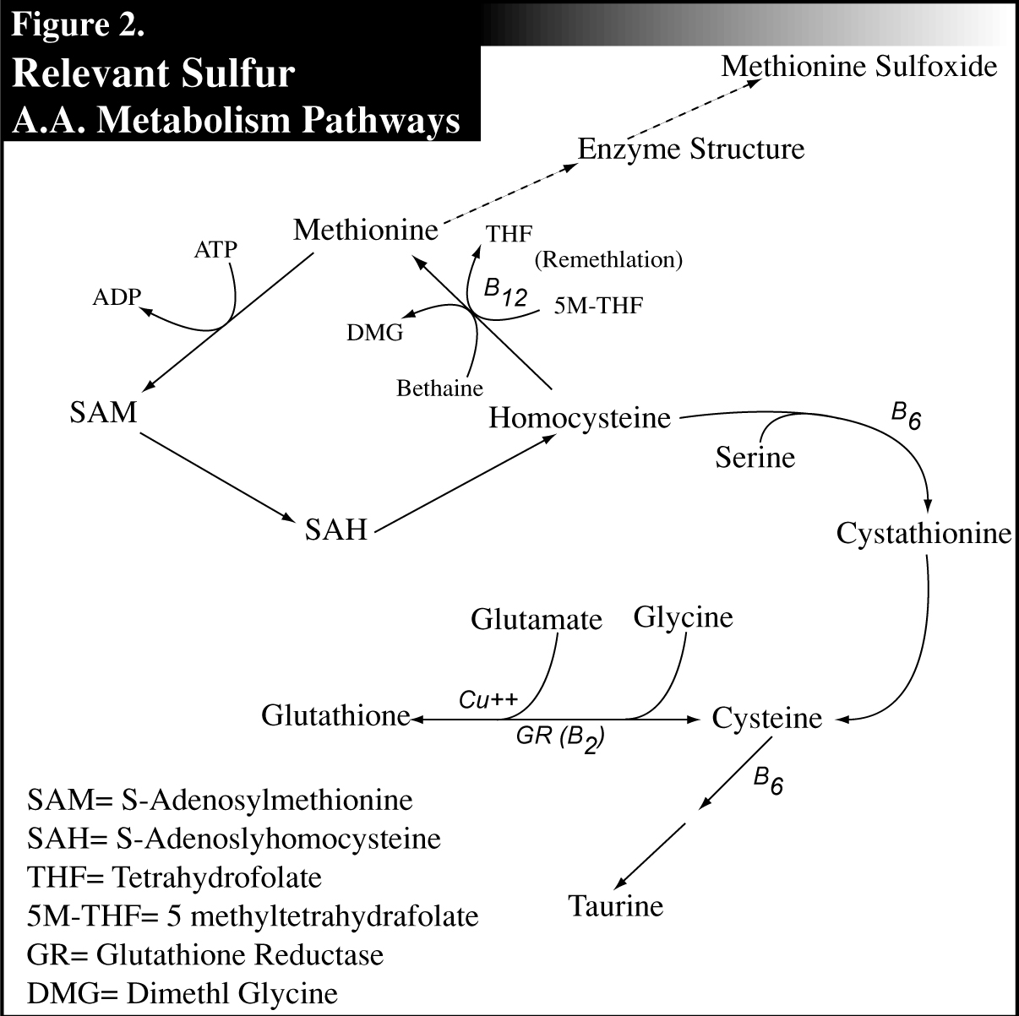
Sulfur A.A. Metabolism Pathways

Slide 7
AA: Plasma
Reflects the dynamics of amino acid exchange between muscle, liver, gut, brain and kidney tissues
Determines the rate of tissue-dependent processes
Due to the strong inherent homeostatic mechanisms, some values may appear normal while being functionally abnormal

Slide 8
AA: Fasting Plasma
Low levels - metabolic hypofunction
  malabsorption
  insufficient intake of protein
  insufficient cofactors
  genetic factors
High levels - metabolic dysfunction
  malabsorption (esp. due to drugs)
  imbalanced protein intake
  insufficient cofactors
  catabolic states

Slide 9
AA: Cofactor Indicators

Slide 10
AA: Reference Ranges
Based on nitrogen balance studies
Predicted on the smallest amounts compatible with normal size growth in infants and children
Published estimates show a wide range of variable needs, even within a single study
Subtle effects on neurological and psychological function rarely even considered in published studies

Slide 11
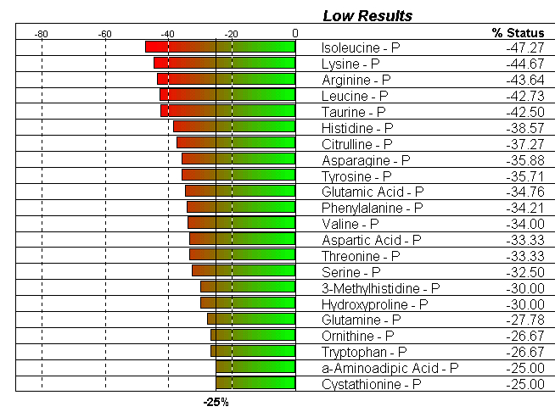
AA: Reference Ranges
This is a pattern of an overall deficiency syndrome that would show no values out of reference range

Slide 12
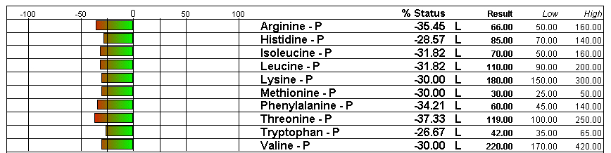
AA: Reference Ranges
This is a pattern of
  poor quality diet
  inadequate digestion/assimilation
  reduced skeletal muscle activity

Slide 13
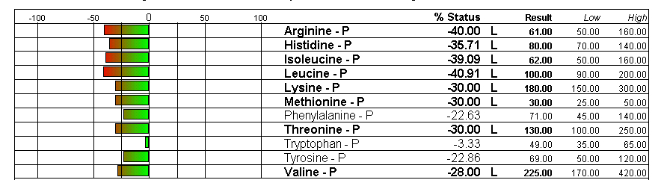
AA: Reference Ranges
This is a pattern of
  Pancreatic enzyme deficiency
  Zinc deficiency

Slide 14
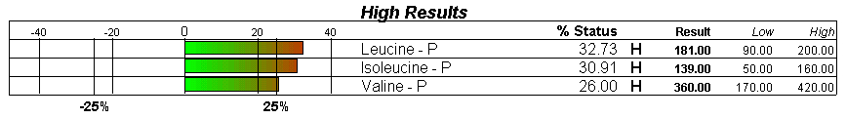
AA: Reference Ranges
This is a pattern of deficiency of
  B6, B5 and
  Zinc

Slide 15
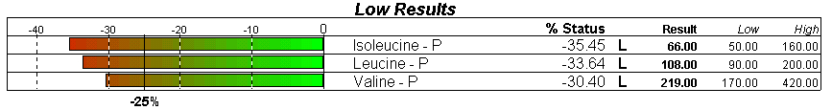
AA: Reference Ranges
This is a pattern of chronic depletion of
  B6, B5 and Zinc
  Branched Chain Amino Acids (BCAA)
  resulting in loss of muscle mass, reduced liver synthesis and sometimes resulting in alopecia or sleep apnea

Slide 16
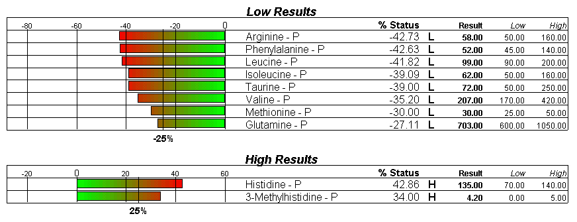
AA: Reference Ranges
Muscle catabolism

Slide 17
AA: BCAA
Not used for neurotransmitter or bile acid formation
Regulators of neurotransmitter metabolism thru competition for binding sites in the brain
Stored in muscle, where converted to glutamine and alanine by liver and kidney
Use in stress induced muscle protein synthesis loss (diabetic, injury, emotional trauma, etc.)

Slide 18
AA: BCAA
↑ BCAAs suggest inadequate B6, B5 (Pantothenic acid spares sulfur aminos). Supplementation will produce coenzyme A and zinc.
↓ BCAAs suggests chronic depletion
BCAAs increase respiration and decrease sleep apnea
Kirvela O, Thorpy M, Takala J, Askanazi J, Singer P, Kvetan V. Respiratory and sleep patterns during nocturnal infusions of branched chain amino acids. Acta Anesthesiol Scand, 1990; 34: 645-8.

Slide 19
AA: BCAA
BCAAs ⇨ Alanine
↓ Alanine suggests B6 deficiency
Alanine carries nitrogen from muscle to liver where it is converted to glucose
Alanine Transferase (ALT), the enzyme in this reaction, is B6 dependant
↓ Alanine = Hypoglycemia

Slide 20
AA: BCAA
Supplementation will
  increase respiration
  decrease sleep apnea
  stimulate food intake in loss of appetite
  slow transit time (in diarrhea)
  leucine inhibits liver protein degradation
Notes:
Supplementation with leucine alone can exacerbate disorders associated with low amino acid levels.

Slide 21
AA: Sarcosine
N-methylglycine, aka Sarcosine, is formed by methyl group transfer from methionine to glycine on the pathway to choline
Cofactors are B12 and folate on pathway to choline
↑ in B2 deficiency on the return pathway to glycine
↑ in Parkinson’s Disease

Slide 22
AA: Hydroxyproline
Synthesized from proline
↑ Urine levels are consistent with high bone turnover
↑ Or normal urine proline and ↓ h-proline indicate vitamin C and iron deficiency
Also correlates with serum alkaline phosphatase, thus also a functional zinc sufficiency indicator
↑ Free plasma h-proline found in multiple myeloma

Slide 23
AA: α-Aminoadipic Acid
Specific marker for B6 (and αKG) [Homocysteine is B12 specific]
Cardiovascular Disease risk marker*
Seen in impaired lysine metabolism
May be connected with neurological disorders (Reynaud’s, petit mal seizures, low BP and susceptibility to herpes outbreaks)
↑ α-Aminoadipic Acid can result from excess lysine supplementation
*Olszewski AJ, Szostak WB. Homocysteine content of plasma protein in ischemic heart disease [published erratum appears in Atherosclerosis 1991, May; 88(1): 97-8.] Atherosclerosis, 1988; 69: 109-13.

Slide 24
Amino Acids: β-Amino Acids
Most abundant:
Taurine
β-alanine
γ-aminobutyrate (GABA)
β-alanylhistidine (Carnosine)
β-alanyl-1-methylhistidine (Anserine)
Notes:
Too much taurine supplementation will result in ↑β-alanine levels, depletion of carnosine and muscle weakness. May use β-alanine to monitor taurine supplementation.
Gut dysbiosis can result in ↑β-alanine levels.
↑β-alanine levels are associated with ↓renal tubular resorption.
Concurrent elevations are often seen in 1- and 3-MH.
Carnosine is a dipeptide containing histidine and β-alanine.
Carnosine conversion to β-alanine is zinc dependent.
Carnosine is predominant in red meat, Anserine in poultry.
Both ↑interleukin-1 in neutrophils and suppress neutrophil apoptosis, thus are immune response modulators
Both ↑Ni carcinogenesis.
Both inhibit Ca uptake by the mitochondria
↑carnosine is associated with mental retardation
Carsinosinase deficiency (Zn dependent conversion to β-alanine and histidine) is associated with progressive neurological problems and sensory polyneuropathy.
↑1-MH inhibits carsinosinase. Zn supplementation stimulates carsinosinase.

Slide 25
Clinical Tips
↓ Taurine suggests excess oxidative damage
Chronic deficiency results in extreme sensitivity to environmental allergens (“universal reactor”)
A key component of bile, ↓ Taurine can result in problems with fat digestion, ↓ Fat soluble vitamins, and ↑ Cholesterol.

Slide 26
Clinical Tips
↓ Taurine contributes to a host of cardiovascular and neurological problems.
↓ Taurine increases platelet aggregation.
Beta-agonist drugs reduce stores of taurine.
↑ Ornithine indicates excess ammonia buildup (Gut bacteria are a major source of ammonia)
↑ Ornithine (any ↑ ammonia) may indicate food intolerance (esp. with ↓BUN)

Slide 27
Clinical Tips
↓ Glutamine suggests ammonia buildup, even more likely when ↑ Glutamic acid
Glutamine levels may fall following amino supplementation if aminos are effective in healing GI tissues

Slide 28
Clinical Tips
↑ Serine:Glycine ratio occurs in depressed individuals
Altamura C, Maes M, Dai J, Meltzer HY. Plasma concentrations of excitatory amino acids, serine, glycine, taurine and histidine in major depression. Eur Neurophsychopharmacolo 1995; 5 Suppl: 71-5.

Slide 29
Clinical Tips
↓Serine and ↑Homocysteine can be normalized with betaine (DMG)
Dudman NP, Tyrell PA, Wilcken DE. Homocysteinemia: depressed plasma serine levels. Metabolism, 1987; 36: 198-201.

Slide 30
Clinical Tips
Excess methionine can chelate copper¹, cobalt¹ and lead².
¹Domingo JL, Llobet JM. Treatment of acute cobalt intoxication in rats with l-methionine. Rev Esp Fisiol, 1984; 40: 443-8.
²Kachru DN, Khandelwal S, Tandon SK. Influence of mehtionine supplementation in chelation of lead in rats. Biomed Environ Sci, 1989; 2:265-70.

