Slide 1
What You Can Learn From Amino Acid Analysis
It’s more than just protein!
Dr. Mark Schauss – Lab Interpretation LLC Copyright 2013

Slide 2
Objectives
Learn what conditions are most often amino acid-related
Learn what groups of amino acids are reported
Learn to determine the sequence of nutritional supplementation
Learn where to go for interpretation of unusual results

Slide 3
Amino Acid Functions
Regulation of muscular activity
Transmission and control of neural signals
Hormonal synthesis and regulation
Nutrient transport mechanisms
Ligament, tendon and bone matrix formation
Enzyme functions

Slide 4
Amino Acids as Neurotransmitter Precursors
Acetylcholine ← methionine (serine and glycine)
GABA ← glutamic acid
Dopamine, norepinephrine ← tyrosine (phenylalanine)
Serotonin ← tryptophan

Slide 5
Amino Acid Functions

Slide 6
Amino Acids: Availability
Composition of dietary protein
Protein digestion
Assimilation & utilization
enzyme cofactors
tissue dependency

Slide 7
Amino Acids: Adequacy Factors
Dietary protein restriction
HCl insufficiency
Gastric and pancreatic enzyme deficiency
Hormonal regulation of secretory processes
Stress demands (↑protein breakdown)

Slide 8
Amino Acids: Demand Variables
Heavy work or physical exercise
Very warm or very cold climates
Aging and the aging process
Health problems - metabolic disorders, chronic diseases, injuries
Use of drugs or alcohol, recent surgery or unique genetic demand

Slide 9
Amino Acids: “Non-Essentials”
Numerous situations require amounts impossible to achieve from dietary intake:
Weight control with severe diet restrictions
Uninformed vegetarianism
Use of antacids
Disease states, Rapid weight loss
Surgical interventions
Chemical or heavy metal exposure/toxicity
Genetic abnormalities, Behavioral disorders

Slide 10
Amino Metabolic Functions
Essential Amino Acids
Arginine, Histidine, Isoleucine, Leucine, Lysine, Methionine, Phenylalanine, Threonine, Tryptophan, Valine
Neuroendocrine Metabolism
GABA, Glycine, Serine, Taurine, Tyrosine
Ammonia/Energy Metabolism
A-Aminoadipic Acid, Asparagine, Aspartic Acid, Citrulline, Glutamic Acid, Glutamine, Ornithine

Slide 11
Amino Metabolic Functions
Sulfur Metabolism
Cystine, Cystathione, Homocystine
Glucose Synthesis
Primary: Alanine, Glycine, Serine
Secondary: All the rest
Creatine
Arginine, Glycine
Tissue Protein Synthesis
All of the 20 essentials and “non-essentials”

Slide 12
Amino Metabolic Functions
DNA/RNA
Primary: Aspartic acid
Secondary: Glutamine, Glycine
Neurotransmitter Synthesis
Glutamic acid, Histidine, Phenylalanine, Tyrosine, Tryptophan, Serine

Slide 13
Amino Metabolic Functions
Derived Amino Acids
Glutamic Acid - Asparagine, Proline, Arginine
Methionine - Serine, Cysteine
Phenylalanine -Tyrosine
Serine - Glycine

Slide 14
Amino Acids: N Compounds
Glutathione - antioxidant, detox pathway
Cysteine, Glycine, Glutamine
Carnitine - fatty acid synthesis
Lysine, Methionine
Creatine - key factor in energy production
Arginine, Glycine, Methionine
Carnosine - nerve transmission
Histidine, β-alanine

Slide 15
Amino Acids: Pathways
Threonine ⇨ Serine ⇨ Glycine
Threonine ⇨ Serine ⇨ Acetylcholine
BCAA’s ⇨ Alanine ⇨ Glutamine ⇨ Glucose
Methionine ⇨ Homocysteine ⇨ Serine ⇨ Cystathionine ⇨ Cysteine ⇨ Taurine
Methionine ⇨ Glycine (methyl group transfer)
Glutamic Acid + AKG ⇨ Glutamine

Slide 16
Amino Acids: Pathways
Proline + Niacin ⇨ Glutamic Acid
Proline + Vitamin C ⇨ Hydroxyproline
Citrulline + [Mg dependant enzyme] Aspartic Acid ⇨ Fumarate (Citric Acid Cycle)
Arginine + Arginase (Manganese dependant) ⇨ Urea
Aspartic Acid + Magnesium ⇨ Asparagine
Notes:
Argininosuccinate synthetase enzyme (Mg dependant)

Slide 17
Methionine is Precursor to:
Choline
Acetylcholine
Creatine
Epinephrine
Antibodies
Cysteine
Glutathione
Coenzyme A
Taurine
Connective tissue proteins
Sulfo-mucopolysaccharides

Slide 18
Classic Signs of Amino Acid Deficiencies
Slow growth (children); poor wound healing
Attention deficit disorders
Chronic fatigue
Emotional disorders
Loss of mental energy
Immune suppression
Night blindness
Infertility and impotence

Slide 19
Positive Responses to Free-Form Amino Acids
Childhood development
Behavior disorders (ADD)
Autistic Spectrum Disorders (ASD)
Addiction(s)
Depression
Bipolar disorder
Chronic fatigue
Obesity
Multiple food sensitivity

Slide 20
What are free-form amino acids?
A free-form amino acid is one that stands alone such as Glycine, Arginine, Lysine, etc.
Protein supplements such as whey and soy contain amino acids but need some form of breakdown to occur in the gut to split the amino acids up.

Slide 21
Benefits of free-form amino acids
No digestion necessary
Absorption is greatly improved
The quantity of specific amino acids is carefully controlled so targeted amino acid supplementation can be accomplished

Slide 22
Why so many respond to amino acids
Protein- & fat-restricted diets
The myth of “Fat is Bad”
Misinformed attempts at weight loss
Drug-induced digestive interferences
Acid blockers & antacids
NSAID’s – Gut effects
Antibiotic degradation of gut ecology

Slide 23
Why so many respond to amino acids
National habit of rushing meals
Remember importance of “How to Eat”
Drug-induced metabolic interferences
Cholesterol and triglyceride-lowering medications
SSRI and other drugs that increase neurotransmitter turnover
Increased detoxification demands

Slide 24
Amino acid status and the “Fat is bad” myth
Fat aids protein digestion
Stomach residence increased
Bile acids help unfold proteins
Pancreatic enzyme action takes time
Works best on small chyme bolus
Final amino acid release achieved by small intestinal enzymes
Rapid passage yields partial release
Undigested peptides acted on by microbes
Amino acids aid fat utilization
Lipoprotein apoproteins
Choline and Carnitine

Slide 25
Protein-Fat Relationships
Protein-rich foods contain fat
Meats, Milk products, Nuts, Eggs, Beans
Low fat diets are low protein diets
The worst combinations are low protein, high carbohydrate diets
Insulin drives breakdown of aa’s
Protein-Fat connections
Fat is transported in blood as lipoproteins
Inhibit protein synthesis ➔ fatty liver
Choline (from AA) aids fatty liver recovery
Carnitine (from AA) essential for fatty acid oxidation

Slide 26
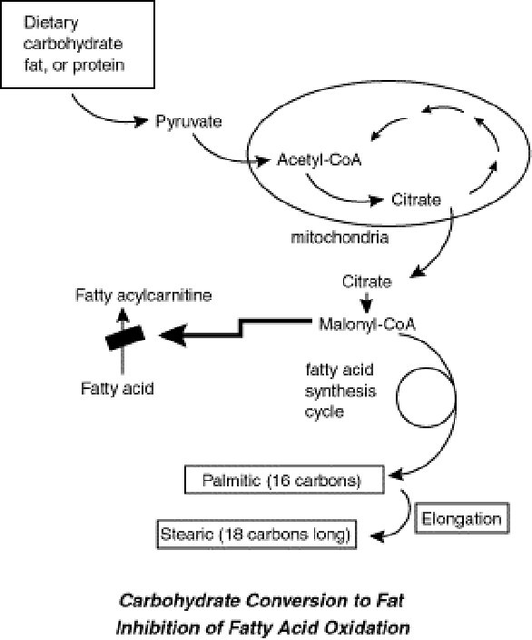
Carbohydrate
Conversion to Fat
Notes:
Formation of longer chain unsaturated FA from ALA, LA and OA occurs via a delta-6-desaturase enzyme function that is Zn dependent (also Mg, B3, B6, and C)
Elevated Mead’s acid will identify a deficiency of LA and ALA, but only if Zn is sufficient.
EPA is formed thru the P5P dependent delta-5-desaturase enzyme processes. Inadequate cofactors mentioned as well as inadequate ALA will result in inadequate EPA.
Fatty acid synthesis is rate-limited by several regulatory enzymes - all protein dependent.
All of the cofactor deficiencies are implied by imbalanced amino levels and identified by organic acid elevations.
80-95% of the volume of adipose tissue is triglycerides. There is usually sufficient available material for conversion to fatty acids, limited only by the available proteins and cofactors.

Slide 27
Fatty Acids: Synthesis
Carnitine synthesis from Methionine, Lysine, Iron and Vitamin C
Carnitine deficiency results in
impaired fatty acid oxidation
failure of gluconeogenesis
results from histidine deficiency
Notes:
Additionally, those labs who are testing for % are testing for numerous fatty acid chains that have not been identified to have any identifyable significance.
That skews the reporting of the others.

Slide 28
Oxidative Energy Metabolism
Proteins
Carbohydrates
Triglycerides
Amino Acids
Glucose
Fatty Acids
Pyruvate
Acetyl Co A
Citric
Acid Cycle
Oxidative Phosphorylation
Notes:
Ox Phos - The major means by which energy is generated in the form of ATP.
Biotin is required for the synthesis of all fatty acids except Linoleic Acid and α-Linolenic Acid which must be derived from the diet.

Slide 29
Factors Leading to Low Amino Acid Levels
Leucine, Isoleucine, Valine & others
Low dietary intake
Phenylalanine / Tyrosine
Increased hormone turnover
Tryptophan
Increased neurotransmitter turnover
Methionine
Limiting dietary amino acid
Arginine
Increased nitric oxide production

Slide 30
Factors Leading to Low Amino Acid Levels
Inadequate dietary supply
Many snack or ‘diet’ foods of low protein quality
Loss of gastric function
Esp. in geriatric population
Loss of pancreatic function
Esp. with Zn deficiency
Malabsorption
Esp. in IBD
Increased utilization
Glycine for detox & heme
Renal failure to resorb
in Glutathione inadequacy

Slide 31
Digestive Demands of Dietary Protein
Dietary protein
NOT SO SIMPLE
Plasma Free Amino Acids

Slide 32
Digestive Demands of Protein
Bile
Dietary protein
LIVER
Bicarbonate
H⁺Cl⁻
Pepsin
PANCREAS
Several
proteases
STOMACH
PANCREAS
Other
proteases
Plasma Free Amino Acids
Small Intestine

Slide 33
Causes of High Plasma AA
Leucine, Isoleucine, Valine, Methionine
High dietary intake, vitamin B6 deficiency
Glutamic acid
Poor Glutamine ---> AKG conversion due to niacin deficiency
Phenylalanine
Phenylketonuria (neonate); iron cofactor for conversion to Tyrosine
Tyrosine
Inadequate catabolic cofactors: iron, copper, iodine, B6 & C

Slide 34
Causes of High Plasma AA
Arginine, Ornithine, Glutamine
Poor arginase activity due to Manganese deficiency consider low protein diet
Hydroxyproline, Proline
Collagen breakdown; need for D and C
GABA
Poor conversion to succinate due to B6 deficiency
Phosphoethanolamine
Functional B12 and folate deficiency or betaine need

Slide 35
Causes of High Plasma AA
a-Amino adipic acid
B6 and AKG for amine group transfer
3-Methylhistidine
Muscle wasting disorders
1-Methylhistidine
Inadequate methyl group transfer due to B12, folate, DMG def.
ß-Alanine
Poor renal tubular resorption

